Slide 1

Python Data Analysis Report
Student Name: Ujala
Course: Python for Data Analysis
Date: 27-12-2025

Slide 2
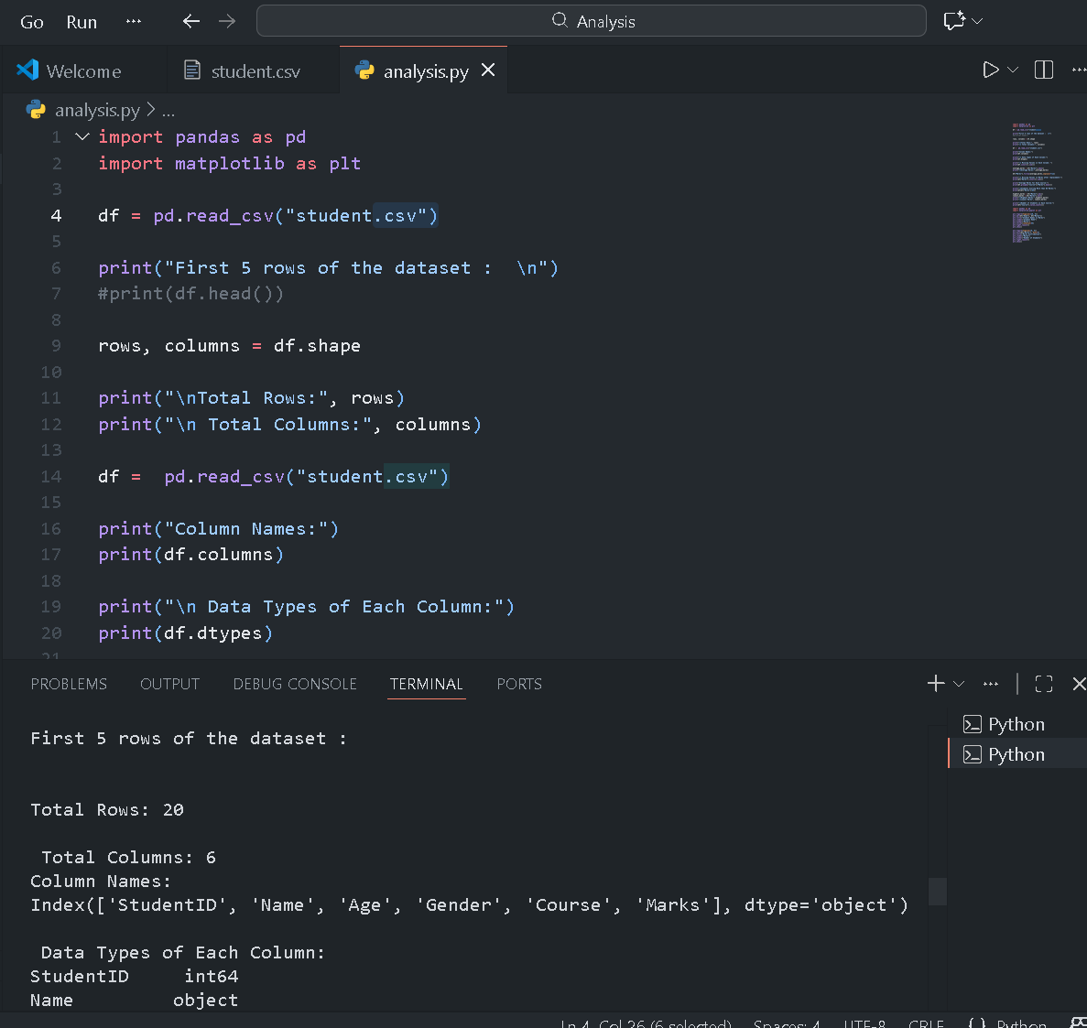
Dataset overview
Number of Records:
20 students
Columns Used:
StudentID
Name
Age
Gender
CourseMarks

Slide 3
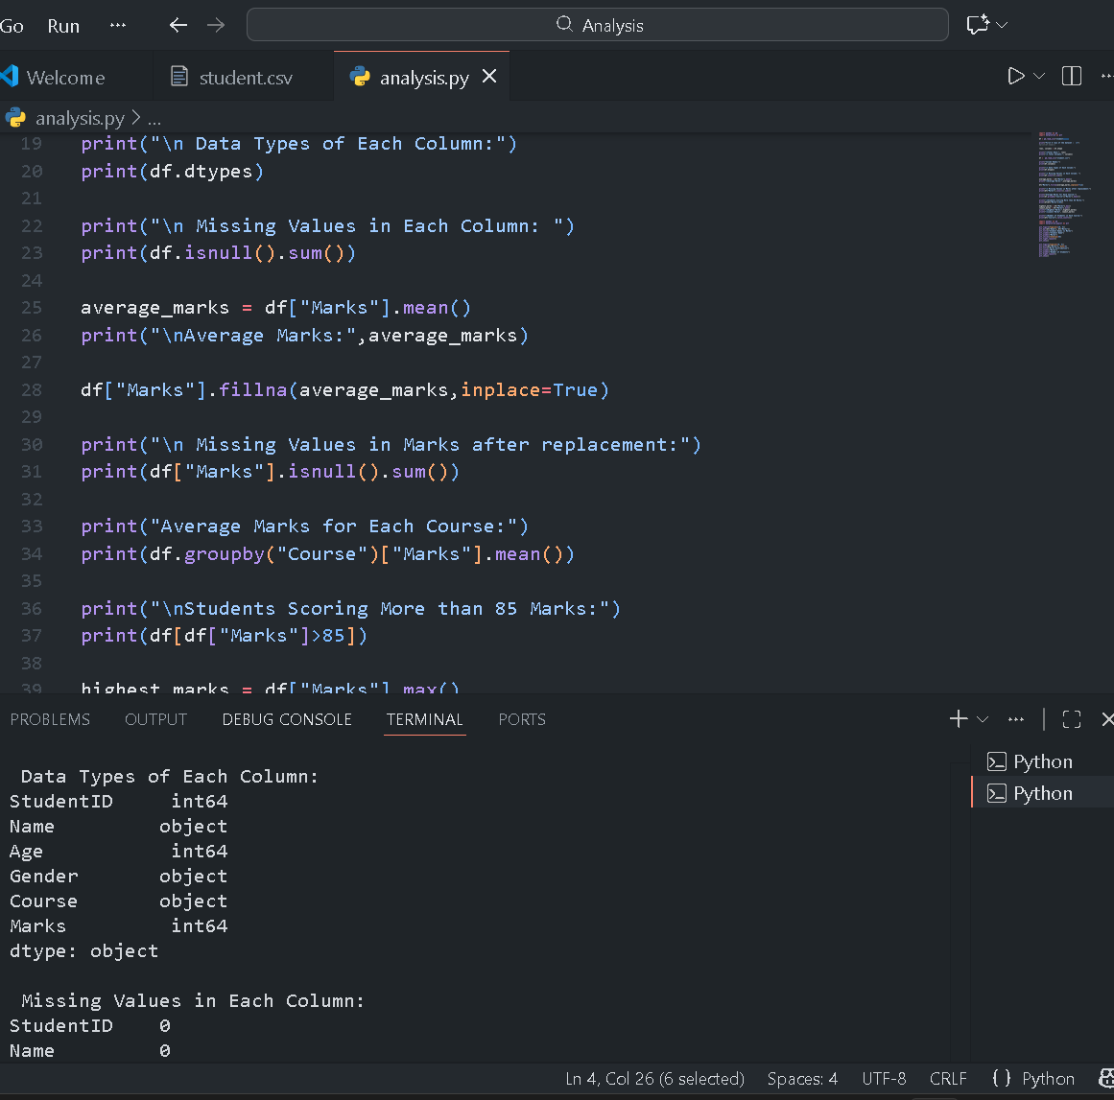
Data Cleaning
Missing Values found:
Marks column had missing values
Attendance column had a few null entries
Handling missing values:
Missing marks replaced with average marks
Missing attendance values replaced with median attendance
Duplicate records removed

Slide 4
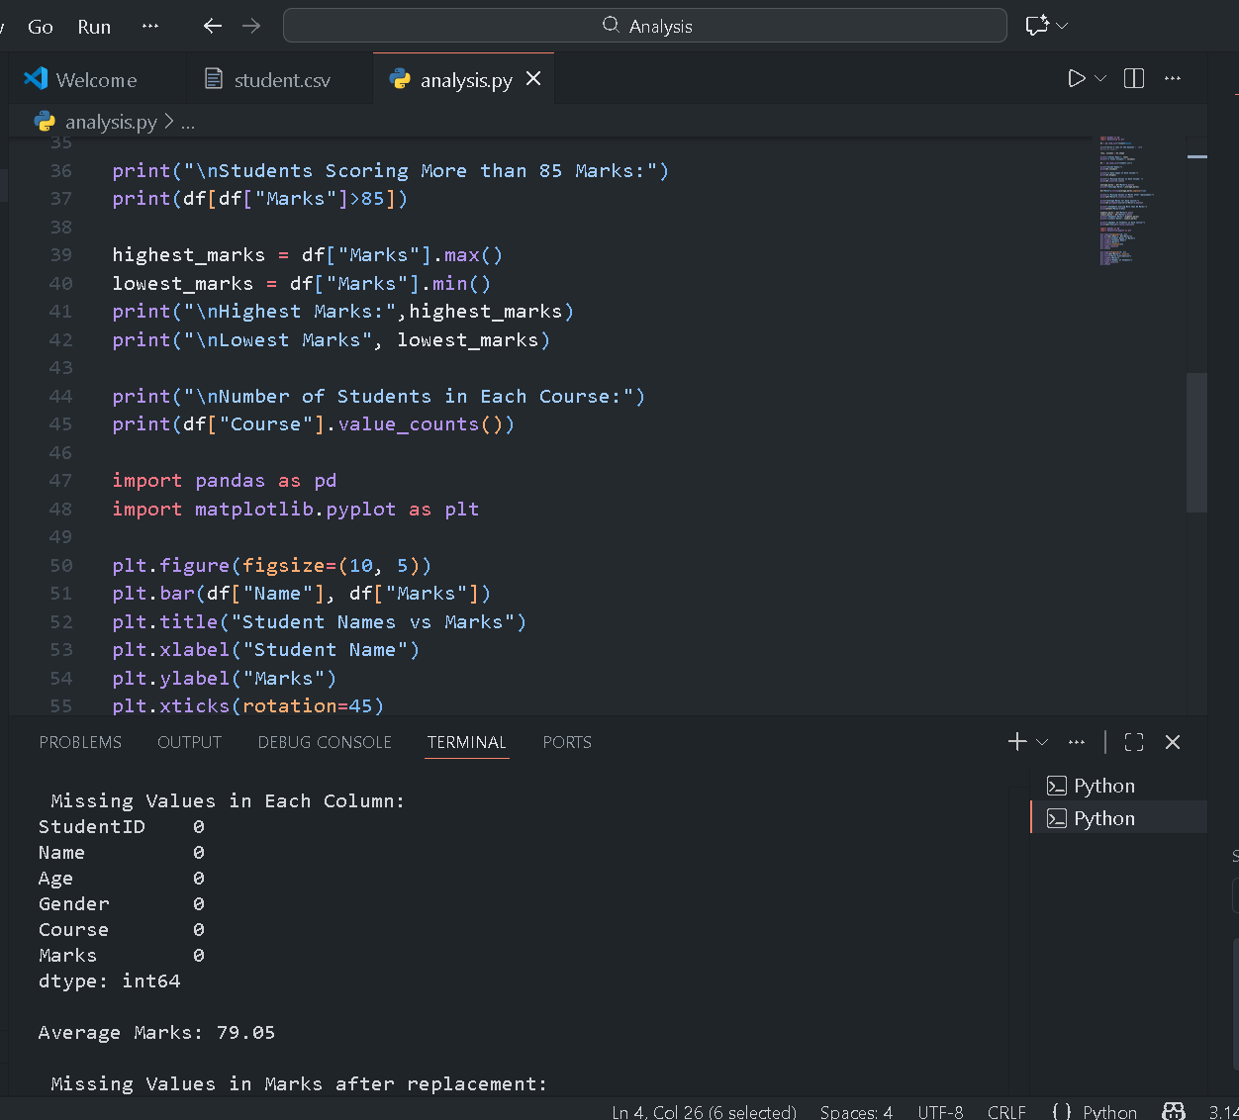
Analysis Insights
Average marks by course:
BCA students scored the highest average
BSc students showed consistent performance
High-scoring students:
Students scoring above 85 were identified
Most top scorers had attendance above 90%

Slide 5
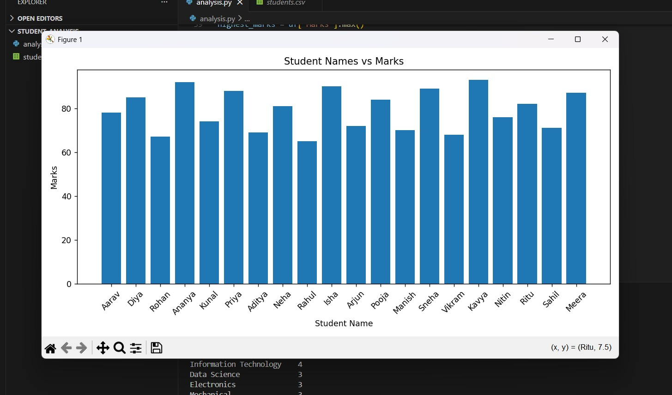
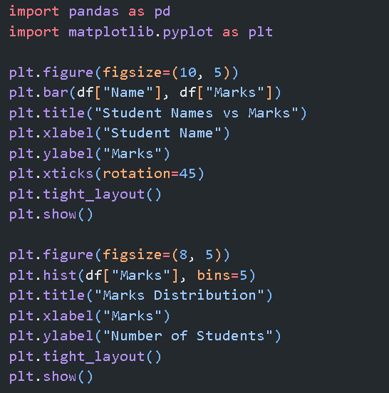
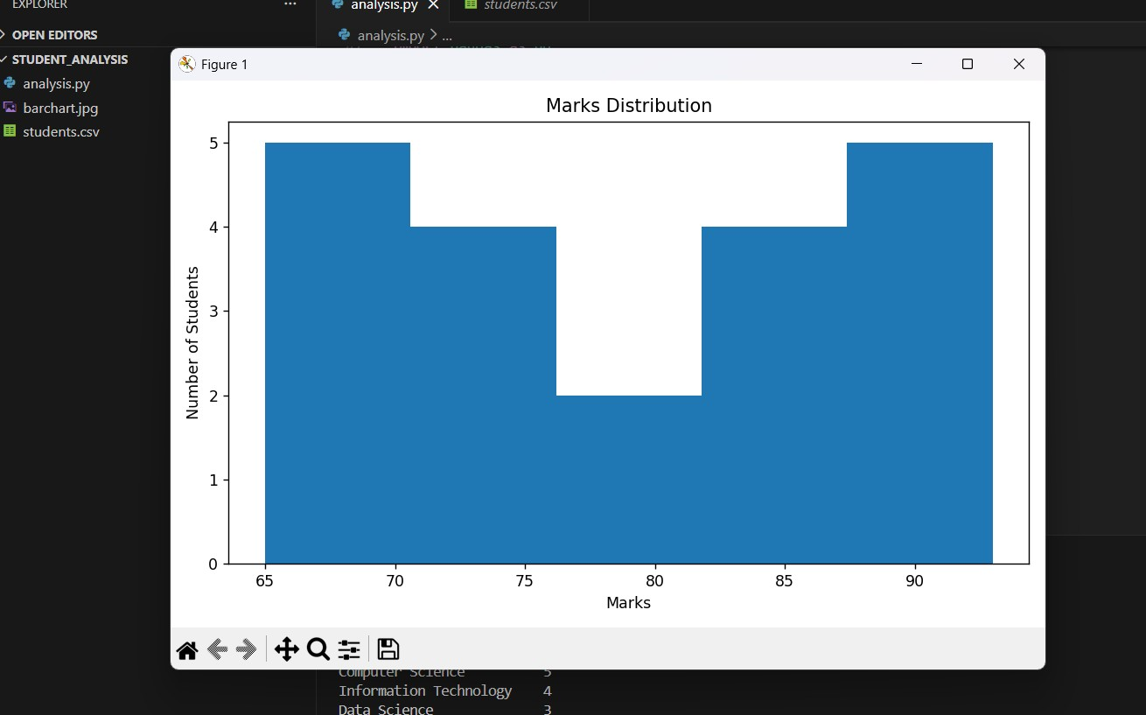
Visualizations
Bar Chart:
Displays average marks for each course
Histogram:
Shows distribution of student marks
Most students scored between 60–80

Slide 6
Conclusion
Key insights:
Higher attendance is linked to better marks
Certain courses show stronger overall performance
One of the goals of effective communication is to motivate your audience
WHAT WE LEARNT:
Data Cleaning using pandas
Creating visualizations using python
Performing basic analytics

Slide 7
Thank you

